Slide 1


DOMAIN | DATA ANALYTICS
Project scope
Student Performance and Assessment Analysis
Data exploration
Preprocessing
Exploratory data analysis
SQL analysis
Dashboard development
PROJECT OBJECTIVE
Analyze student assessment data, identify performance patterns, and present insights through visualizations and an interactive dashboard.
Technologies
Python
Pandas
Matplotlib
Seaborn
MySQL Workbench
Power BI
END-TO-END PROJECT WORKFLOW
Original Dataset
abhiva_dataset.csv
Python Exploration
and Cleaning
Cleaned Dataset
cleaned_data.csv
MySQL Workbench
SQL Analysis
Power BI
Interactive Dashboard
Notes:
(About 45 seconds)
Good morning everyone. My project is called Student Performance and Assessment Analysis, and it belongs to the data analytics domain.
The goal was simple: take student assessment data, find patterns in how students performed, and show those insights through charts and an interactive dashboard.
The scope covers five steps: exploring the data, cleaning it, exploratory data analysis, SQL analysis, and building a dashboard.
I used Python with Pandas, Matplotlib and Seaborn for cleaning and charts, MySQL Workbench for SQL, and Power BI for the dashboard.
At the bottom you can see the full workflow. We start with the original file, abhiva_dataset.csv, clean it in Python, save a new cleaned_data.csv, and then use that cleaned file in MySQL Workbench and in Power BI. I will come back to this flow on every slide.

Slide 2


Problem Statement and Objectives
The Problem
Objectives
Student assessment datasets contain marks, percentages, subjects, grades, attendance, and teachers.
1
Explore and understand the dataset
2
Handle missing values and prepare data for analysis
3
Analyze student performance using Python and SQL
Systematic analysis helps identify performance patterns and makes the data easier to understand.
4
Develop meaningful data visualizations
5
Build an interactive Power BI dashboard
abhiva_dataset.csv
Python cleaning
cleaned_data.csv
MySQL analysis
Power BI dashboard
Notes:
(About 1 minute)
This slide explains why the project exists.
On the left is the problem. Student assessment data holds a lot of information: marks, percentages, subjects, grades, attendance and teacher names. But in raw form it is just a large table, and it is hard to see patterns by looking at rows.
Systematic analysis solves this. It turns the table into something we can understand quickly.
On the right are my five objectives, and they follow the order of the project. First, explore and understand the dataset. Second, handle missing values and prepare the data. Third, analyze performance using Python and SQL. Fourth, create meaningful visualizations. Fifth, build an interactive Power BI dashboard.
So each objective is one step of the workflow, and the next slides show how I completed them.

Slide 3




Dataset and Data Preprocessing
20,000
PREPROCESSING WORKFLOW
Original records
1
2
3
4
5
15
Explore
Missing values
Duplicates
Data types
Save
Dataset structure and statistical summaries
Identified and handled
Checked duplicate records
Corrected types, including the date column
Saved as cleaned_data.csv
Number of columns
17,928
Dataset: abhiva_dataset.csv | Key attributes
StudentID
StudentName
Grade
Subject
Final cleaned records
AssessmentID
QuestionID
TotalMarks
MarksObtained
Percentage
AttemptDate
TeacherName
AttendanceStatus
abhiva_dataset.csv
Python cleaning
cleaned_data.csv
MySQL analysis
Power BI dashboard
Notes:
(About 2 minutes)
This slide is about the data and how I prepared it.
The dataset is abhiva_dataset.csv. It originally had 20,000 records and 15 columns. After cleaning, 17,928 records remained in the final cleaned dataset. The key attributes include student ID and name, grade, subject, assessment and question IDs, total marks, marks obtained, percentage, attempt date, teacher name and attendance status.
Now the five preprocessing stages, from left to right.
One: I explored the structure and statistical summaries to understand the columns and values.
Two: I identified missing values and handled them. Missing data can make averages and counts unreliable, so this step matters.
Three: I checked for duplicate records, so the same record is not counted twice.
Four: I corrected data types, especially the date column, so that trends over time can be analyzed properly.
Five: I saved the result as a separate file called cleaned_data.csv. The original file stays untouched.
Why Python? Pandas is very good for inspecting and cleaning tabular data. And this cleaned file is the single source used in both MySQL Workbench and Power BI, which keeps every result consistent.

Slide 4


Exploratory Data Analysis and SQL
Python analysis
SQL analysis: MySQL Workbench
SELECT Subject, AVG(Percentage)
FROM student_data
GROUP BY Subject
HAVING COUNT(*) > 0
ORDER BY AVG(Percentage) DESC;
Illustrative sample charts, not project results
Simplified illustration of a query
10 visualizations: Matplotlib, Seaborn, Pandas
Subject-wise performance
Attendance and percentage distribution
Performance trends over time
Marks obtained versus total marks
Grade-wise and teacher-wise performance
Retrieval and filtering
SELECT, WHERE
Sorting and unique values
ORDER BY, DISTINCT
Aggregations
COUNT, SUM, AVG, MIN, MAX
Grouped analysis
GROUP BY, HAVING
abhiva_dataset.csv
Python cleaning
cleaned_data.csv
MySQL analysis
Power BI dashboard
Notes:
(About 2 minutes)
This slide covers the analysis, done in two ways: Python on the left, SQL on the right. Both use the same cleaned dataset, which is why the arrow connects them.
Python first. I created 10 visualizations using Matplotlib, Seaborn and Pandas. They look at subject-wise performance, attendance distribution, and the distribution of percentages. They also show performance trends over time, compare marks obtained with total marks, and examine grade-wise and teacher-wise performance. The two small charts here are only illustrative samples, to show the type of visual. They are not my project results. Python is the right tool here because it lets me explore quickly and see patterns visually.
Now SQL, using MySQL Workbench. After saving cleaned_data.csv, I imported it into MySQL. I used SELECT and WHERE to retrieve and filter data. ORDER BY and DISTINCT to sort and find unique values. COUNT, SUM, AVG, MIN and MAX for aggregations. And GROUP BY with HAVING for grouped analysis. The query on the slide is a simplified example of the idea: group records by subject and average the percentage.
Why both? Python gives visual exploration, while SQL shows I can query a database in a structured way. Together they confirm and complement each other.

Slide 5
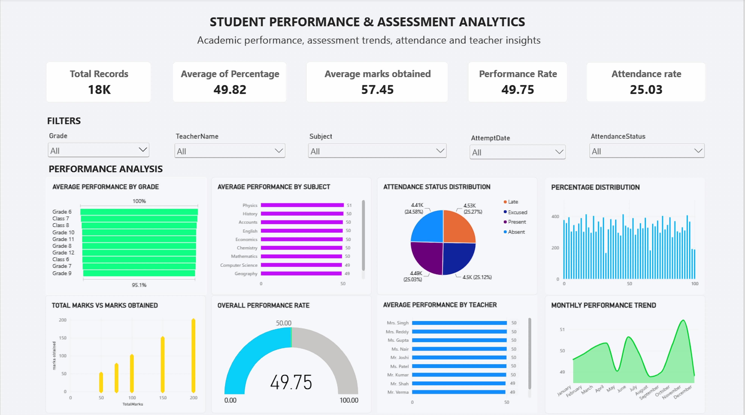

Student Performance and Assessment Dashboard
Objective: enable users to explore assessment data, compare categories, and understand performance patterns interactively.
Interactive filters
Grade
TeacherName
Subject
AttemptDate
AttendanceStatus
Dashboard contents
5 KPI cards
8 interactive visuals
5 filter controls
abhiva_dataset.csv
Python cleaning
cleaned_data.csv
MySQL analysis
Power BI dashboard
Notes:
(About 3 minutes)
This is the most important slide: the interactive Power BI dashboard I built, Student Performance and Assessment Analytics. This is a screenshot of my actual dashboard.
Start at the top with the KPI cards: Total Records, Average of Percentage, Average Marks Obtained, Performance Rate and Attendance Rate. They give a quick summary of the whole dataset at a glance.
Below the cards are the filters: Grade, Teacher Name, Subject, Attempt Date and Attendance Status. When a user selects a value, every card and chart updates together. So a teacher or manager can ask, for example, how one subject or one teacher is performing, and see the answer immediately.
Then the performance analysis section has eight visuals. Average performance by grade, by subject and by teacher, so we can compare categories. The attendance status distribution. The percentage distribution. Total marks versus marks obtained. The overall performance rate gauge. And the monthly performance trend, which shows how performance moves over time.
Why Power BI? Static charts answer fixed questions. A dashboard lets users ask their own questions. It connects to the cleaned dataset, so the whole workflow ends here: raw data, cleaning in Python, SQL analysis, and finally interactive reporting.
The objective is simple: help users explore the data, compare categories and understand performance patterns on their own. If there is time, I can demonstrate the filters live.

Slide 6



Challenges, Outcomes and Conclusion
PROJECT DELIVERABLES
Challenges addressed
Cleaned dataset
Python notebook
cleaned_data.csv
Exploration, cleaning, visualization
Identifying and handling missing data
Maintaining appropriate data types
Importing the cleaned CSV into MySQL Workbench
Configuring Power BI visualizations and KPI cards
SQL queries
Power BI dashboard
Data retrieval and analysis
Interactive analysis
SKILLS DEMONSTRATED
Data preprocessing
Exploratory data analysis
SQL querying and aggregation
Data visualization
Dashboard development
Conclusion The project demonstrates an end-to-end data analytics workflow, from raw data preparation to analytical visualization and interactive reporting.
abhiva_dataset.csv
Python cleaning
cleaned_data.csv
MySQL analysis
Power BI dashboard
Notes:
(About 1 minute 15 seconds)
To close, I will cover the challenges, the outcomes and the conclusion.
Challenges. First, identifying and handling missing data, which needed careful checking. Second, keeping the right data types, especially dates. Third, importing the cleaned CSV into MySQL Workbench. Fourth, configuring Power BI visualizations and KPI cards. Solving each of these taught me something practical.
Deliverables. I produced four things: the cleaned dataset, cleaned_data.csv; a Python notebook for exploration, cleaning and visualization; SQL queries for retrieval and analysis; and the Power BI dashboard for interactive analysis.
Skills. Through this I practiced data preprocessing, exploratory data analysis, SQL querying and aggregation, data visualization and dashboard development.
In conclusion, the project demonstrates an end-to-end data analytics workflow. It starts with raw data preparation, moves through analysis and visualization, and ends with interactive reporting. Thank you. I am happy to take any questions.

